Slide 1


SeqAn BioStore Workshop 2014
Knut Reinert
Freie Universität Berlin Institute for Computer Science

Slide 2
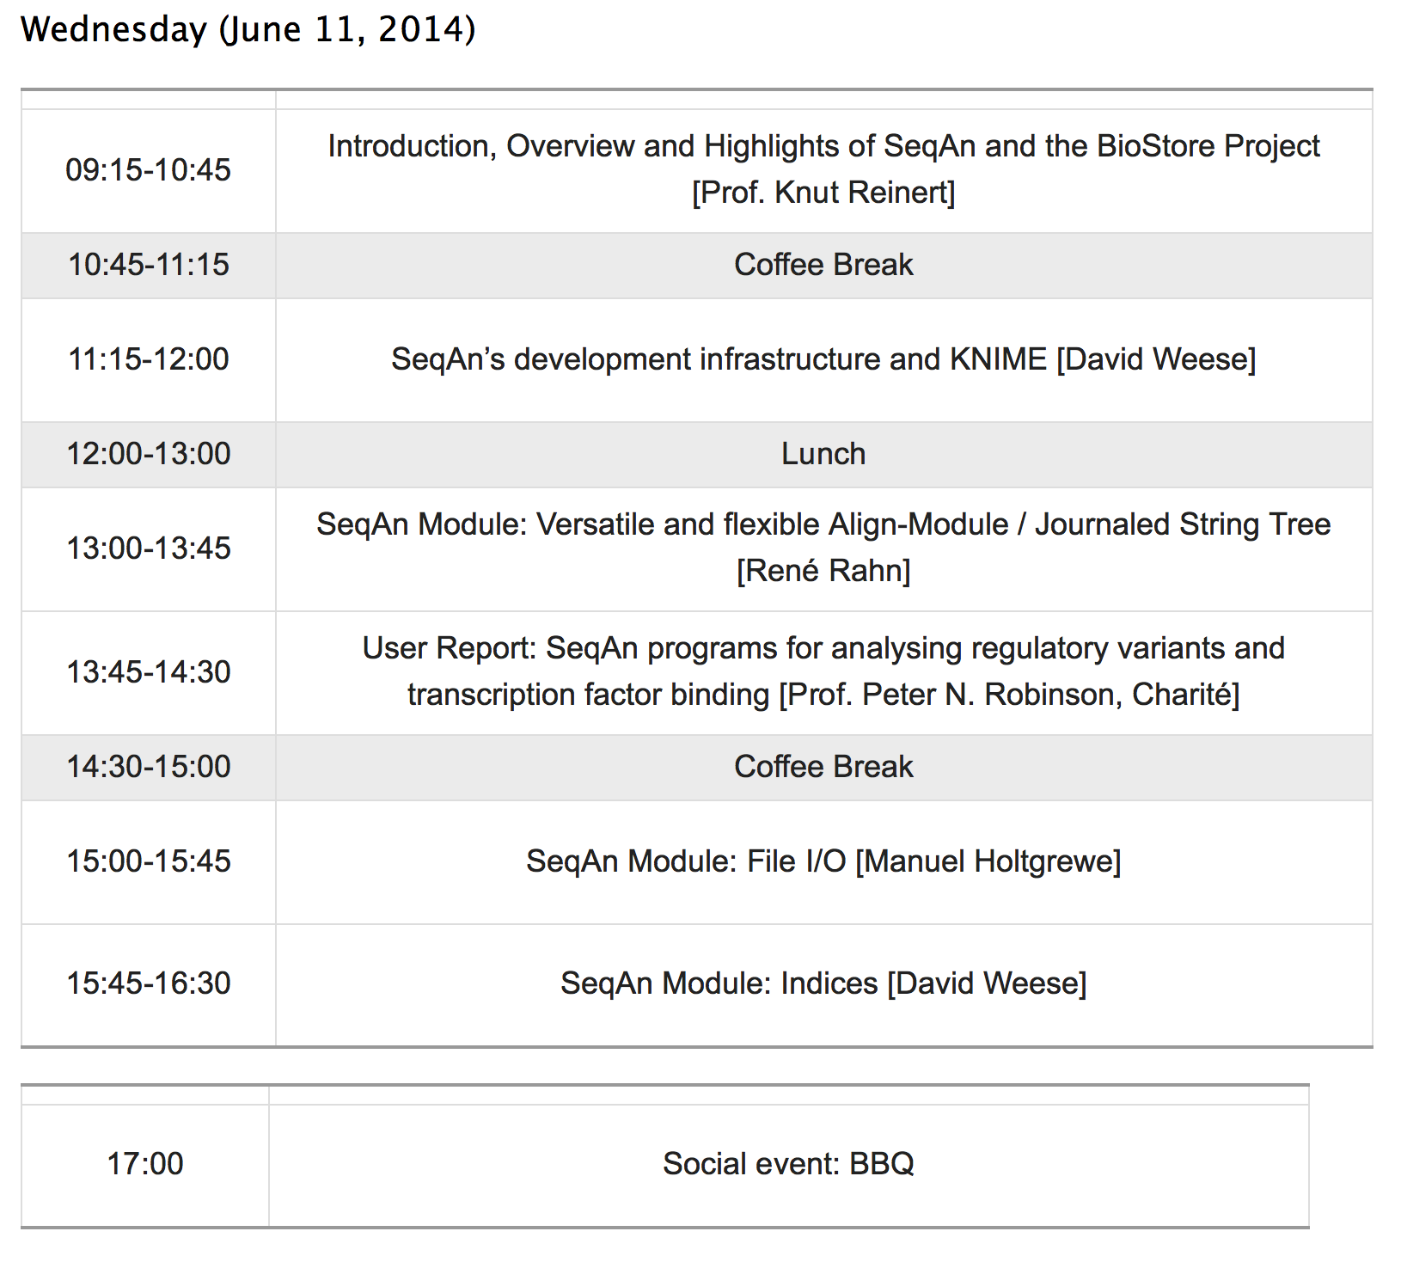

Slide 3
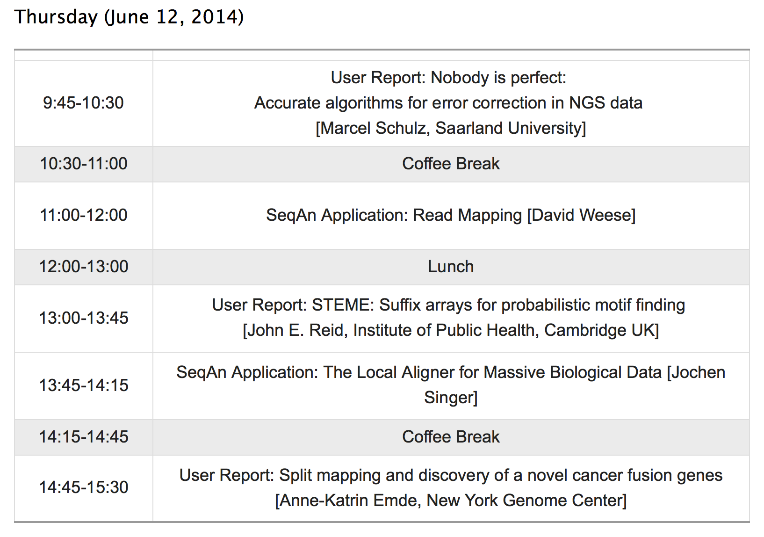

Slide 4
Why SeqAn ?

Slide 5
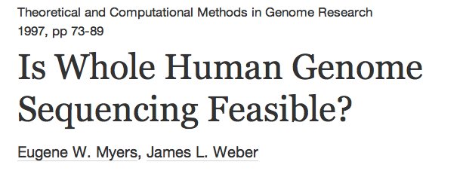

Slide 6
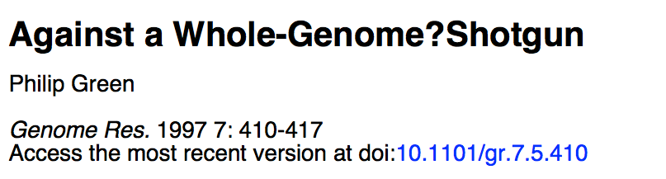
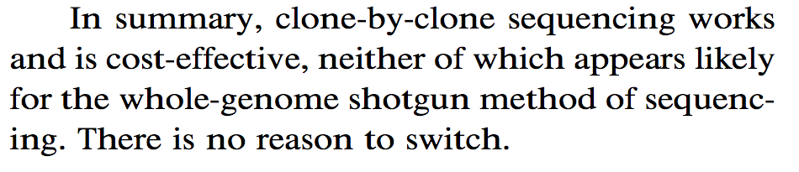
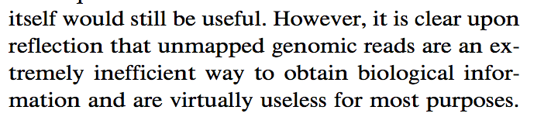

Slide 7
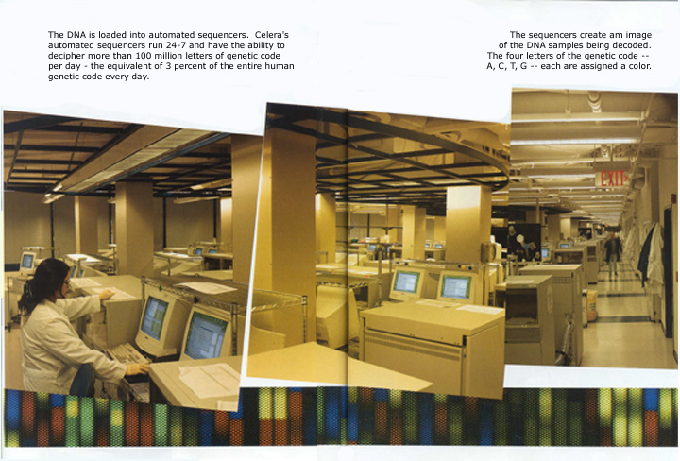
~ 13 years ago...
Data volume and cost:
In 2000 the 3 billion base pairs of the human genome were sequenced for about 3 billion US$ Dollar
100 million bp per day

Slide 8
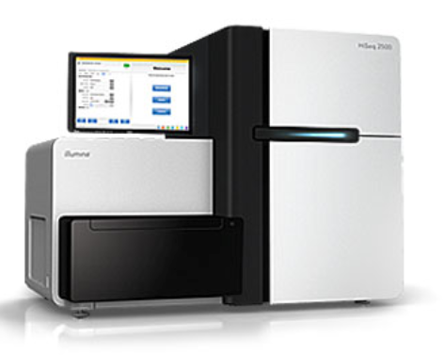
Sequencing today...
Illumina HiSeq
100 billion bps per day
Within roughly ten years sequencing has become about 10 million times cheaper

Slide 9
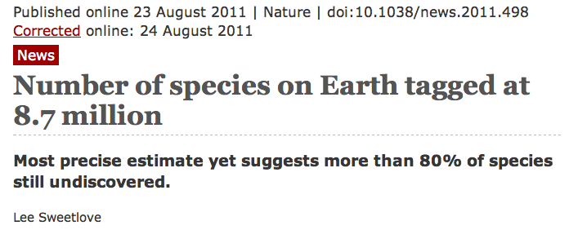
Sequencing earth?
10⁷ species x 10⁸ genome size =>
earth genome has 10¹⁵ bps
10⁴ Hiseqs can each sequence 10¹¹ bps per day =>
earth genome at 10x in 10 days

Slide 10
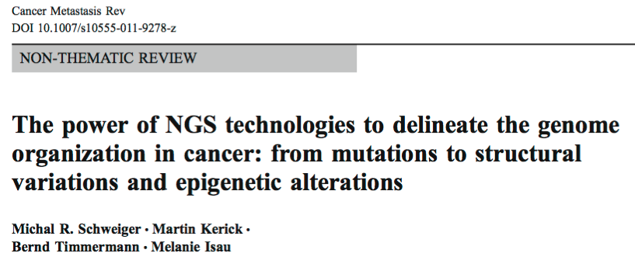
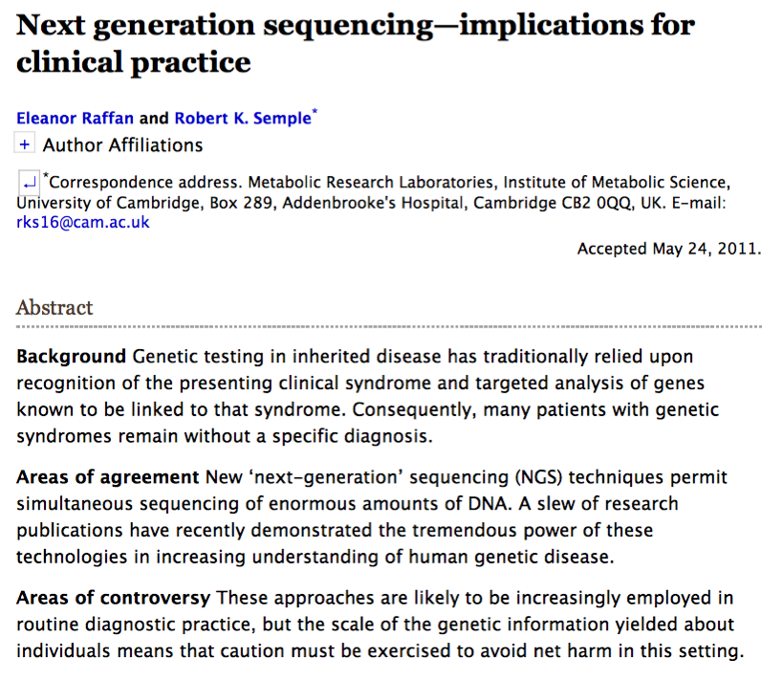
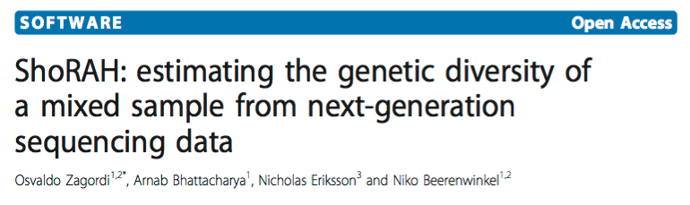
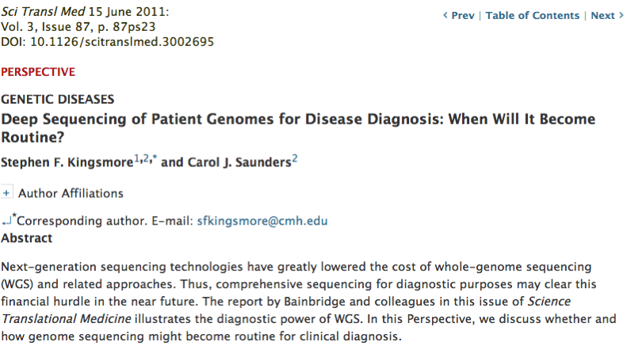
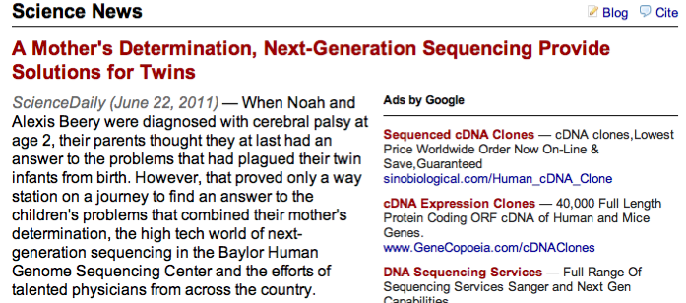

Future of NGS data analysis

Slide 11
Why is translational research hard?
Result 1
Quality 0.75
Result 3 Quality 0.35
Medical doctors/Biologists
Result 2 Quality 0.95
Biomedical Modelers
Implementation 1 Quality 0.65
Engineers (Hardware)
Implementation 3 Quality 0.85
Implementation 2 Quality 0.75
Engineers (Software)
Algorithm 3 quality 0.95
Algorithm 1 quality 0.75
Algorithm 2 quality 0.45
Algorithm 4 quality 0.85
Algorithmicists Mathematicians
0.95*0.85*0.95=0.76

Slide 12
Software libraries bridge gap
RNA-Seq
Structural variants
Metagenomics abundance
ChIP-Seq
Sequence assembly
Cancer genomics
We need to be very good
on all levels
FM-index
Multicore
Secondary memory
K-mer filter
Suffix arrays
Fast I/O
Hardware acceleration

Slide 13
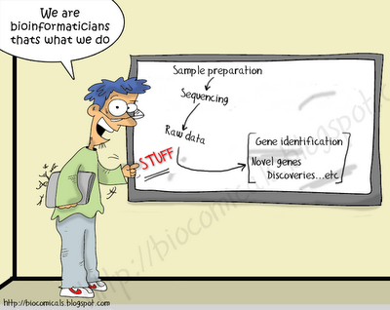
This talk
Translational research

Slide 14
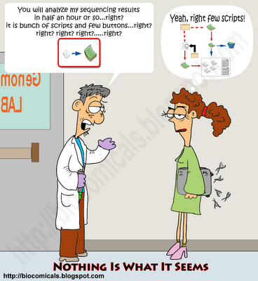
Expectations changed...

Slide 15
This talk
SeqAn SDK
SeqAn data structures
SeqAn apps

Slide 16
SeqAn in a nutshell
SeqAn is an open source C++ library of efficient algorithms and data structures for the analysis of sequences with the focus on biological data.
SeqAn applies a unique generic design that guarantees high performance, generality, extensibility, and integration with other libraries.
SeqAn is easy to use, and it simplifies the development of new software tools with a minimal loss of performance.

Slide 17
SeqAn
Now SeqAn/SeqAn tools have been cited more
than 360 times
Among the institutions are (omitting German institutes):
Department of Genetics, Harvard Medical School, Boston, European Bioinformatics Institute, Wellcome Trust Genome Campus, Hinxton, J. Craig Venter Institute, Rockville MD, USA, Department of Molecular Biology, Princeton University, Applied Mathematics Program, Yale University, New Haven, IBM T.J. Watson Research Center, Yorktown Heights, The Ohio State University, Columbus, University of Minnesota, Australian National University, Canberra, Department of Statistics, University of Oxford, Swedish University of Agricultural Sciences (SLU), Uppsala, Graduate School of Life Sciences, University of Cambridge, Broad Institute, Cambridge, USA, EMBL-EBI, University of California, University of Chicago, Iowa State University, Ames, The Pennsylvania State University, Peking University, Beijing University of Science and Technology of China, BGI-Shenzhen, China, Beijing Institute of Genomics……
Is under BSD license and hence free for academic AND commercial use.

Slide 18
SeqAn developers

Slide 19

BMBF VIP Program
German ministry for Education and Research
Intro to market
Implementation
Industry mentor:
Dirk Evers, Molecular Health
Market potential
Orientation
Idea
time

Slide 20
SeqAn BioStore (old slide)

Slide 21
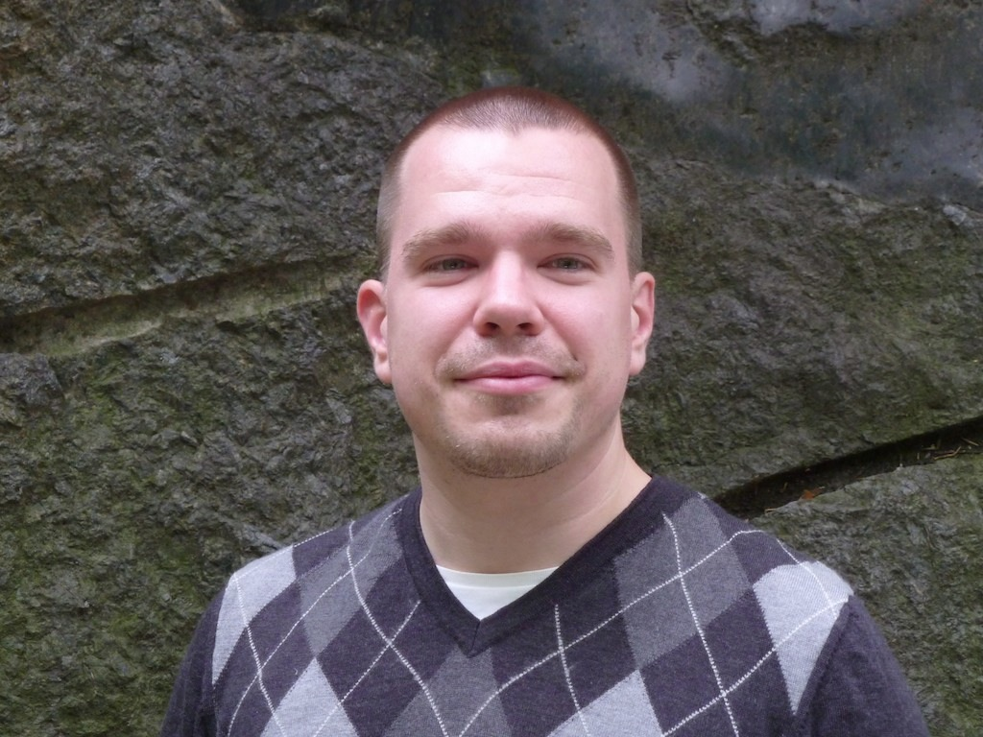
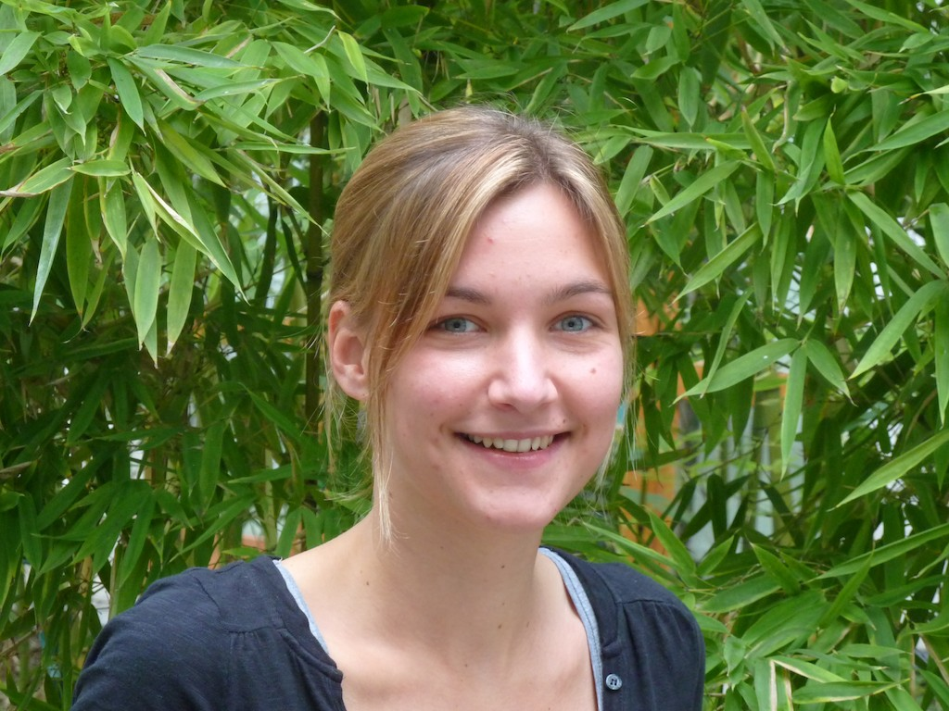
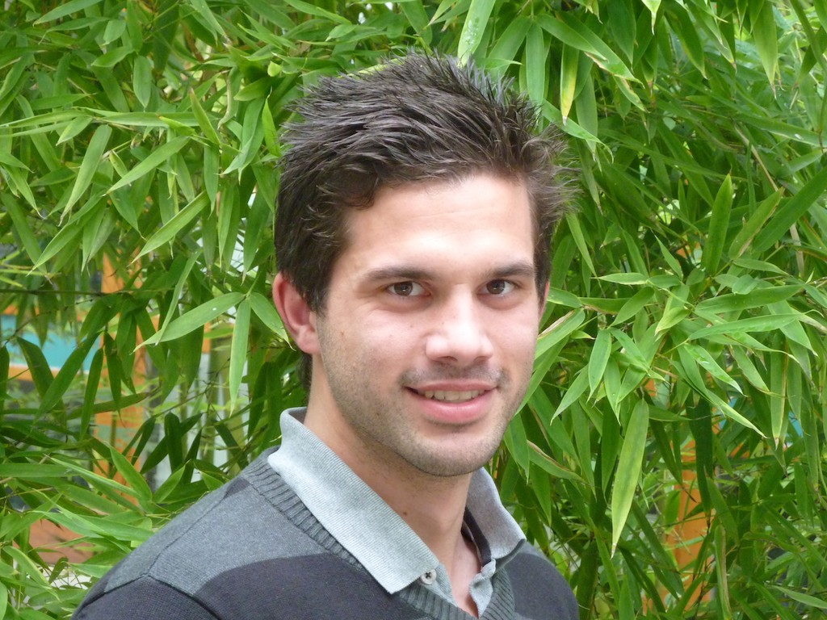
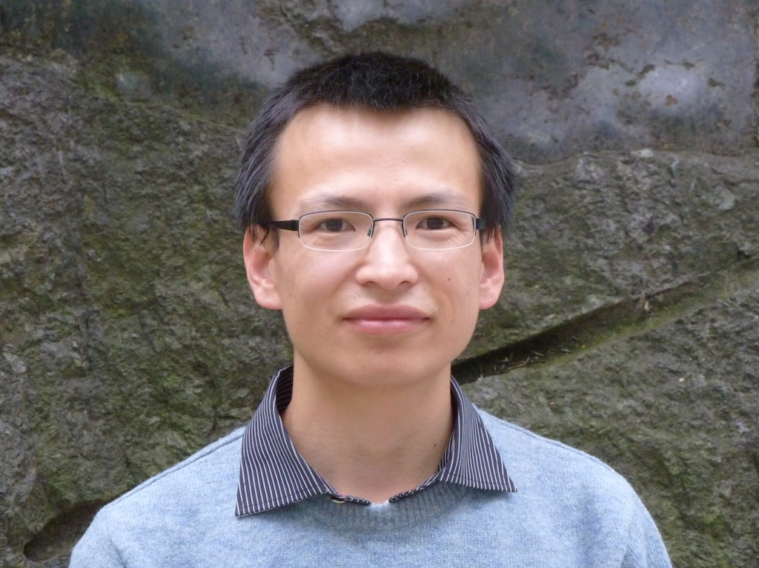
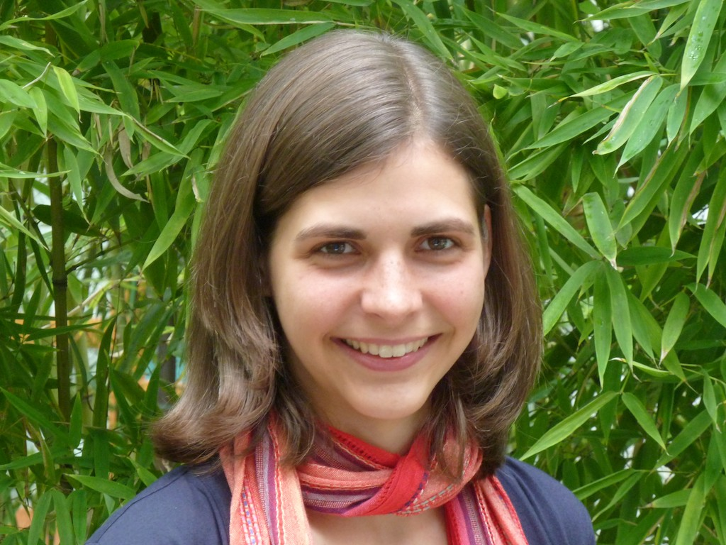
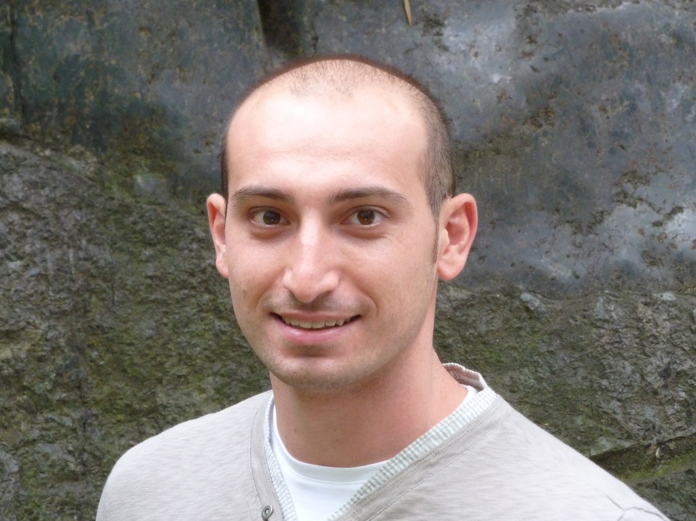
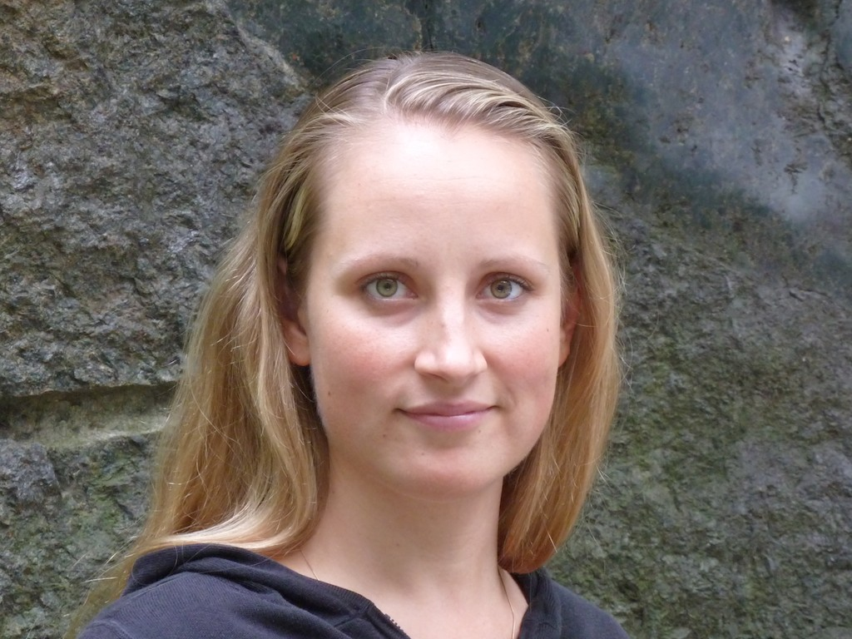
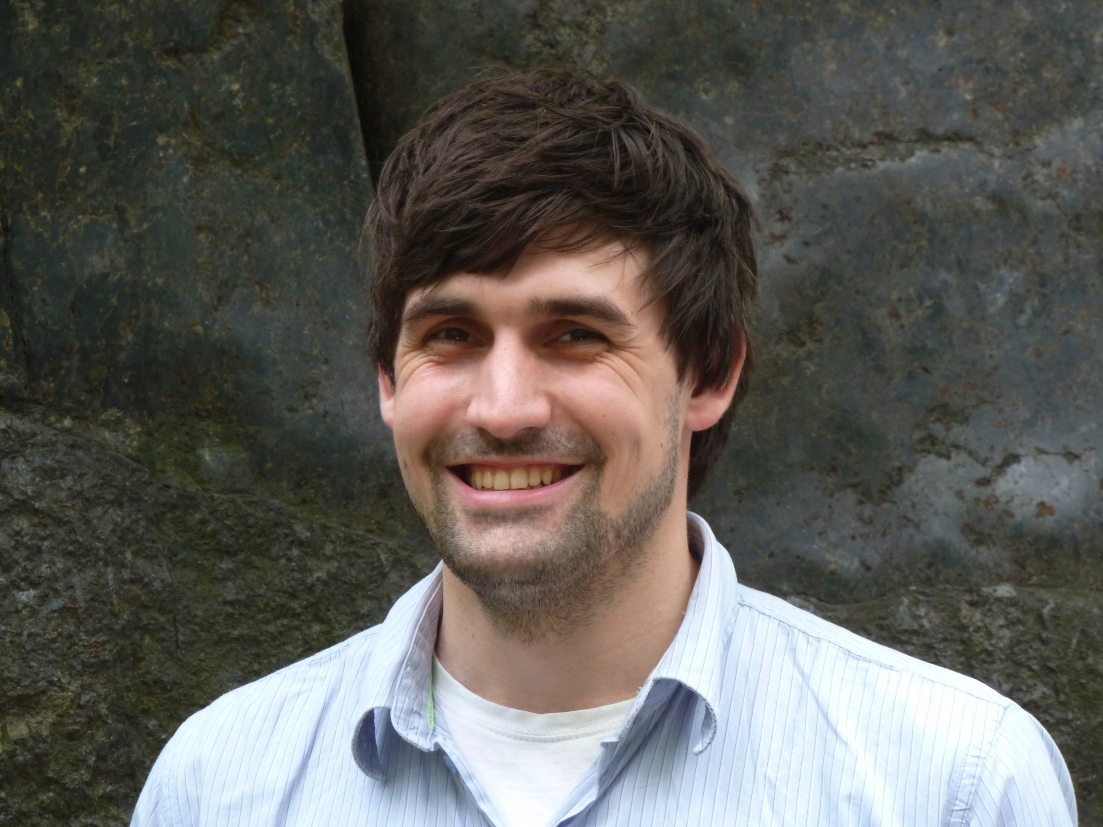
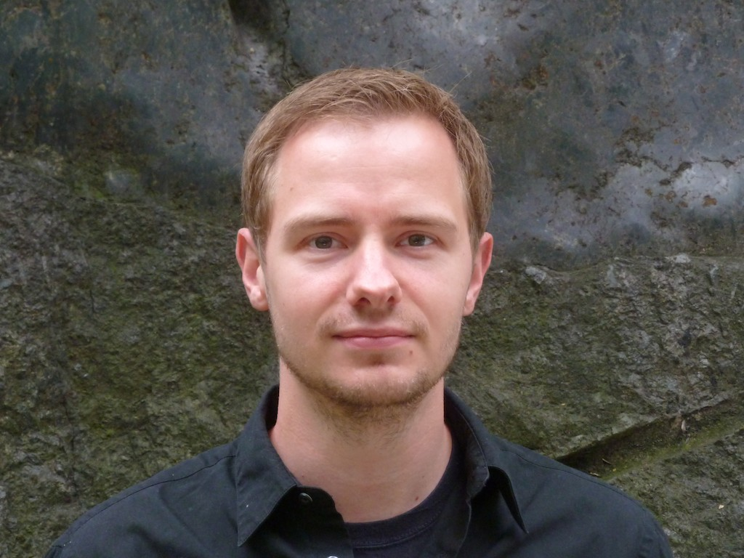
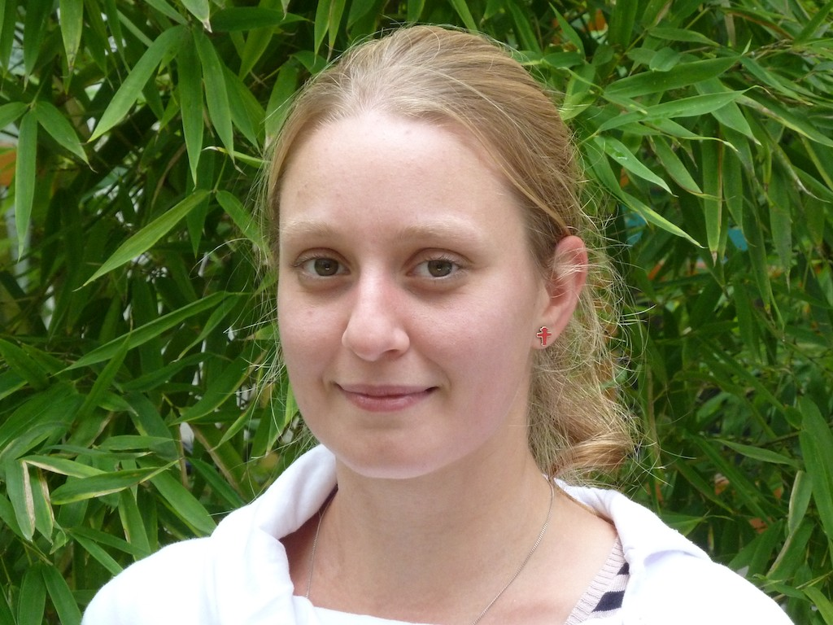
SeqAn team
Genome comparison
(Evolutionary models due to new breakpoint distance,
Local alignments to find syntheny blocks)
David Weese
Björn Kahlert
Sabrina Krakau
Jochen Singer
Manuel Holtgrewe
Parallelization of indices
(Multicore, GPU, Xeon Phi), Error correction, Read mapping
Metagenomics and bisulphite mapping
BlastX replacement, Bisulphite analysis
Useability and KNIME support
Jialu Hu
Birte Kehr
Enrico Siragusa
Anne-Katrin Emde
Variant detection
(SNPs, small indels, insert assembly, split read mapping)
Network analysis
(Network alignment)
Data parallelism
(Data parallel iterators, dynamic indices)
René Märker
Stephan Aiche
Kathrin Trappe
Leon Kuchenbecker (Charité)
Temesgen Dadi
Hannes Hauswedell
Oliver Stolpe (Charité)

Slide 22
SeqAn usability

Slide 23
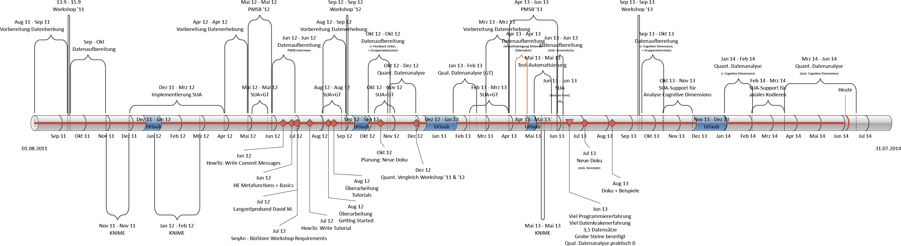
Usability Improvement Timeline
Notes:
August `11 – May `12 Focus on data collection
June `12 – September `12 Focus on getting rid of obvious usability problems - like improvement of tutorials - later: online documentation
October `12 – August `13
Focus on data analysis tool
Since Octover `13
Deep data analysis using Grounded Theory (social science)

Slide 24
Research Approach
Core Research Method: Grounded Theory
Collected Data
coding and documentation usage of all workshop participants
(Group) Interviews
Questionnaires
Feedback
Cognitive Dimensions
Data Collection
Data Preparation
Open Coding
Axial Coding
Selective Coding
Sampling
Notes:
Data Collection / Preparation
All information on the slide
Open Coding Axial Coding Selective Coding
Found phenomena / conspicuousness (e.g. using the wrong function) are conceptualized (e.g. ambiguous naming)
Concepts are put in relation
Sampling
- Gaps in theory are clarified using a targeted data collection

Slide 25
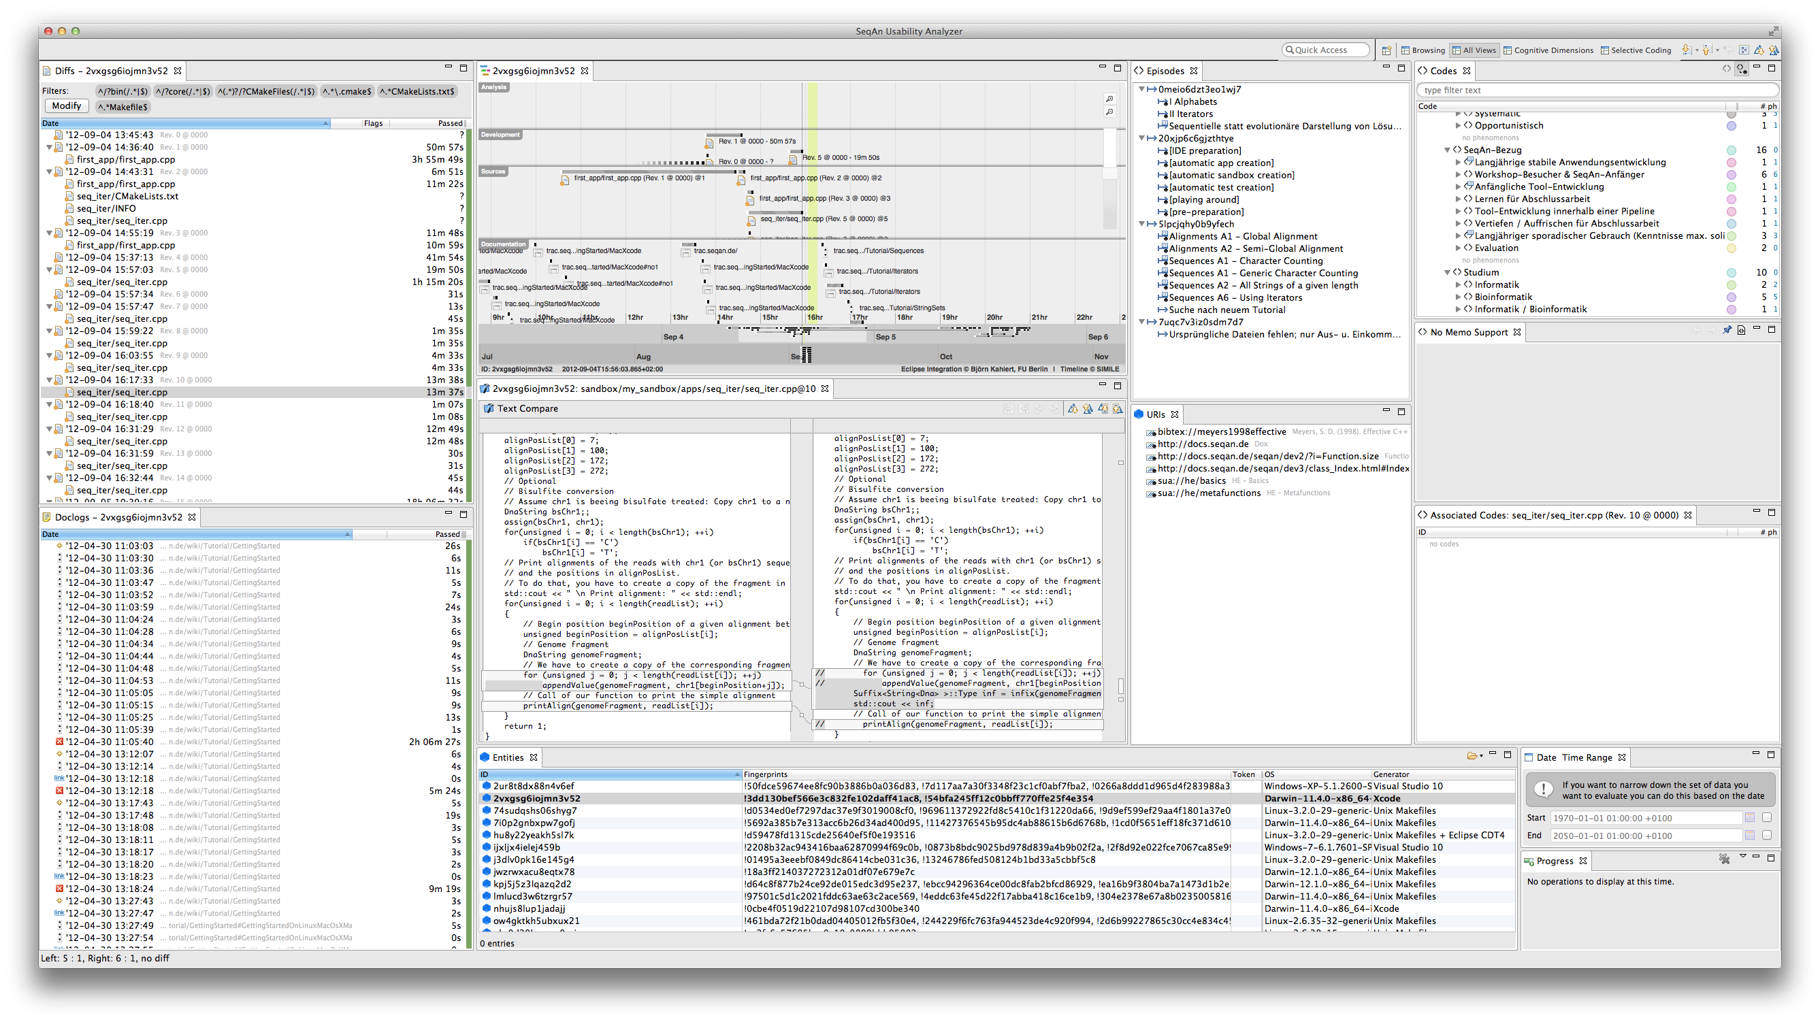
Usability Analysis Tool: SeqAn Usability Analyzer
TIMELINE
C files
Made changes
Pseudonymized participants
Notes:
C Files
all files edited between two compilations
Made Changes
Changes made to the file in question
Timeline
- Changed files and all actions (even scrolling and loosing focus) of online documentation
Participants
- ~ of the currently opened data set (e.g. workshop `13)

Slide 26
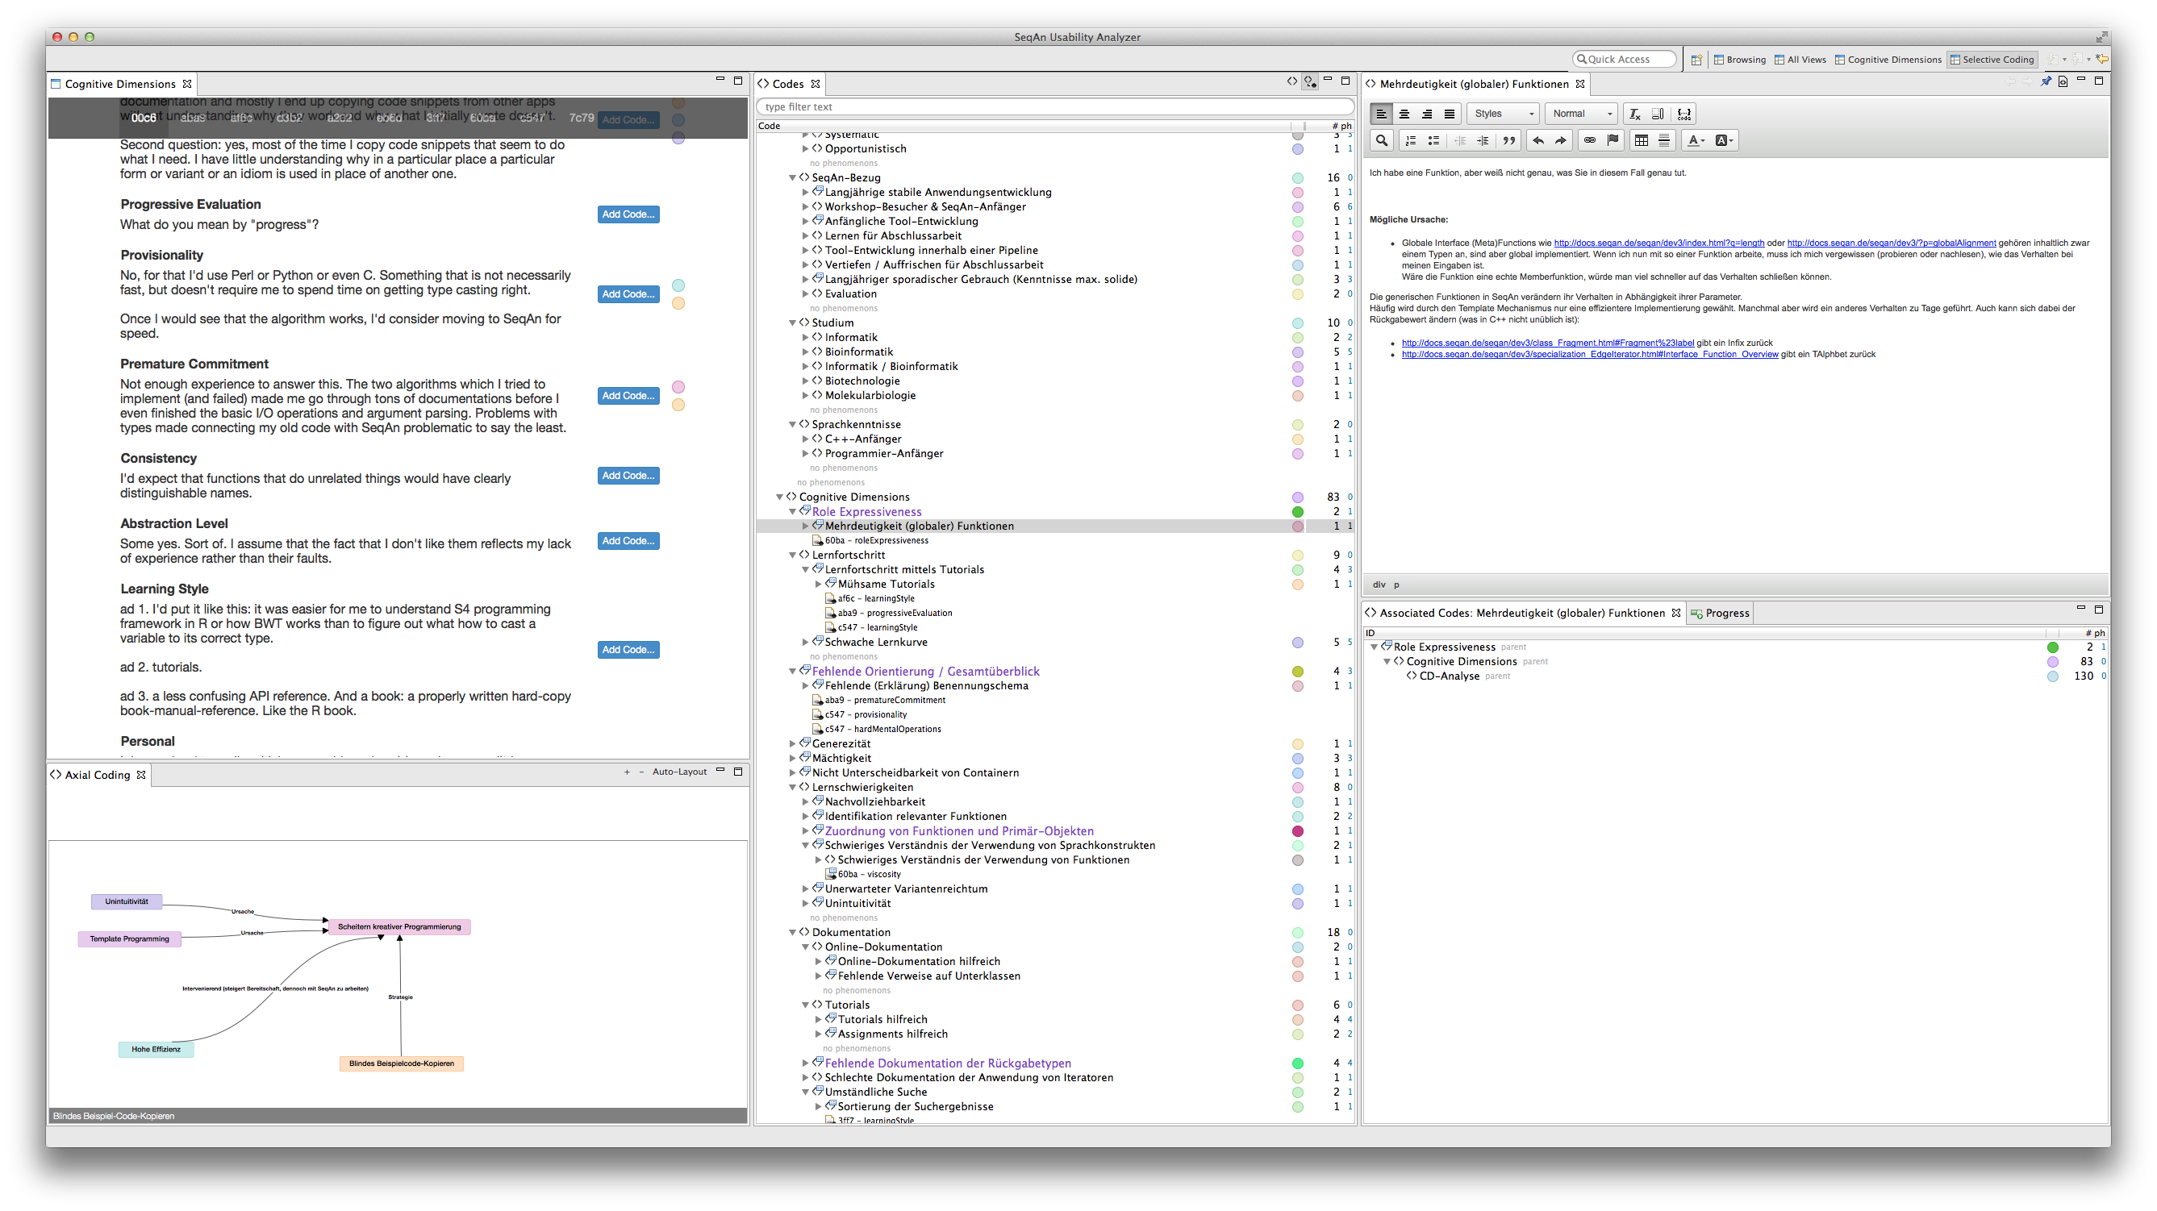
Usability Analysis Tool: SeqAn Usability Analyzer
Conceptualized Phenomena
Memos
Annotated Questionnaire
Selective coding support
Notes:
Questionnaire
All participants questionnaires with annotated concepts
Conceptualized phenomena
All discovered concepts in a tree view
Memos
Detailled notes about the current selection (phenomenon or concept)
Selective Coding
Concepts in relation

Slide 27
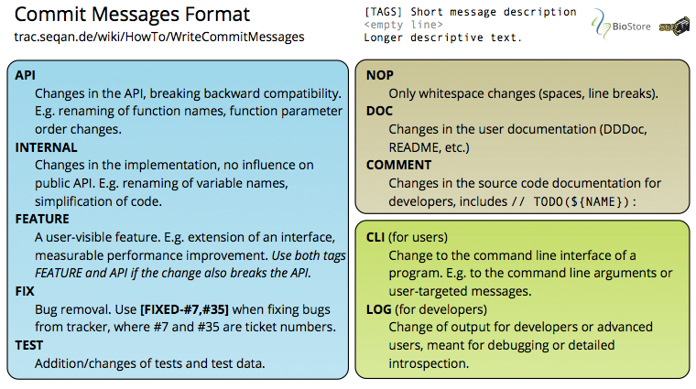
Improvements so far
Easier tracking of changes thanks to unified commit messages
Notes:
Blue
Core codes
Brown
Docs & Comments
Green
- Internal logging & command-line-interface

Slide 28
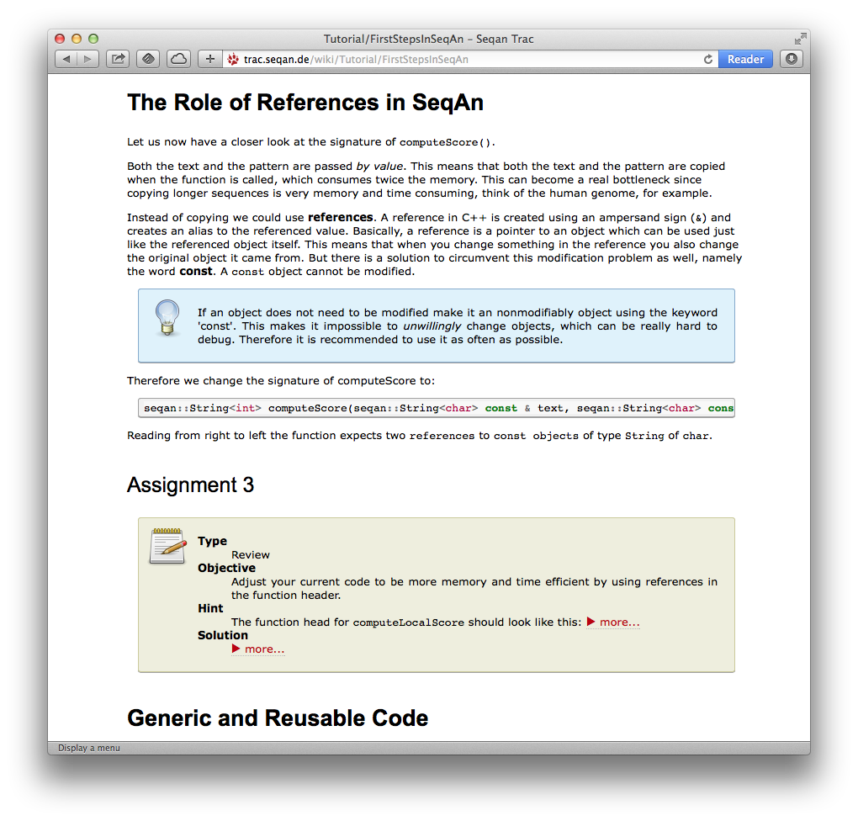
Improvements so far
Improved tutorials
Unified
Empasis on didactics
Notes:
Unified
All tutorials look the same
„ have been reviewed
Didactics
Meta information (Difficulty, prerequisites, ...) for each tutorial
Meta information (Type, Objective, ...) for each assignment
Optional information (e.g. further reading)

Slide 29
Improvements so far
New Documentation

Slide 30
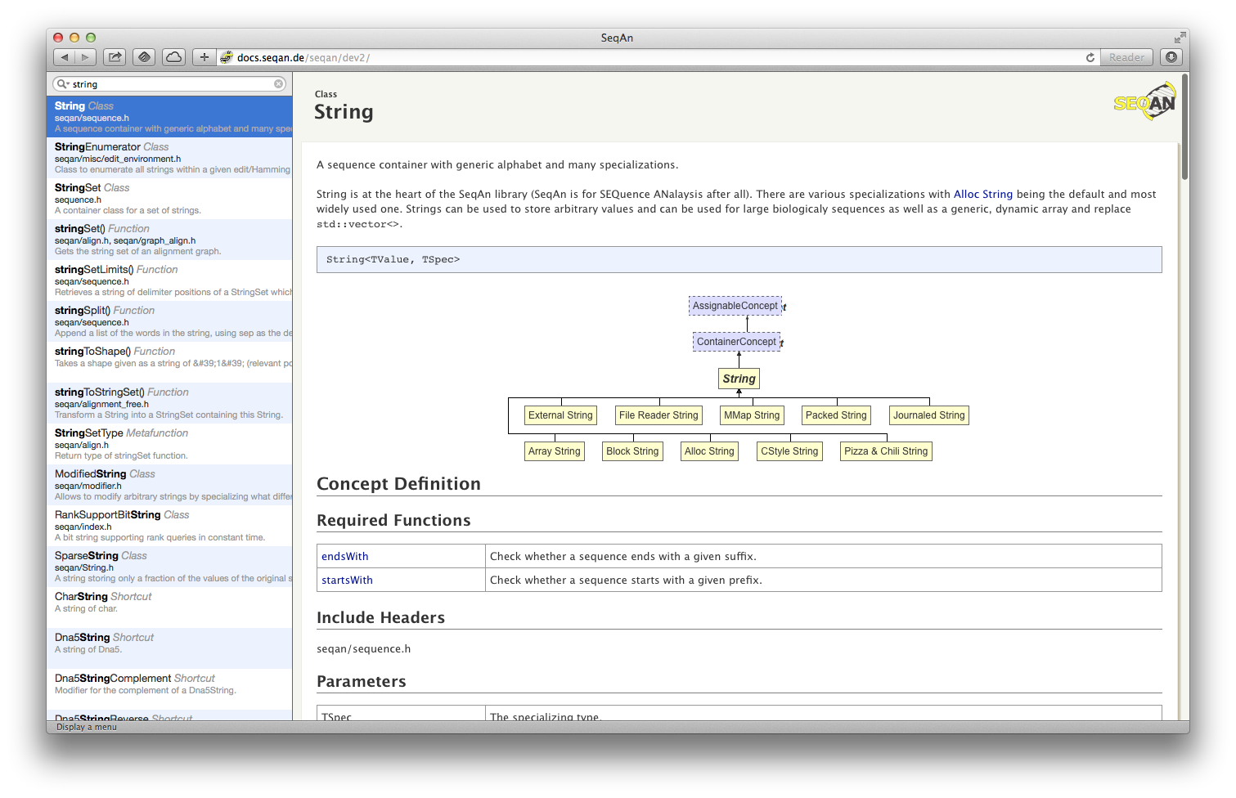
Notes:
Old documentation

Slide 31
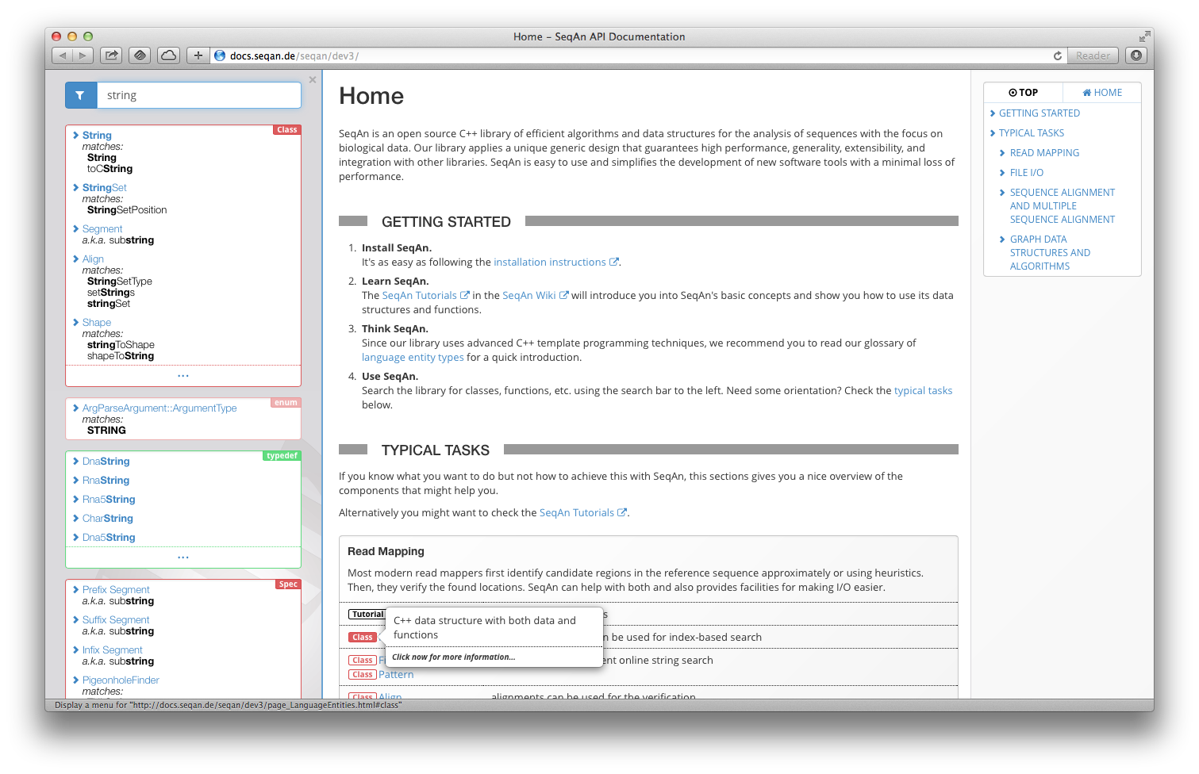
Filters
Navigation
GROUPING
REDUCTION
SYNONYMS
Type Annotations
Notes:
New documentation
Features
Filters filtering search result types
Grouping group by search result type (e.g. classes, functions)
Reduction Class search results don‘t consume the whole space
Synonyms finds infix using substring
Type annotations meta information to the nature of the hovered element (e.g. class, meta functions) + short description
Navigation

Slide 32
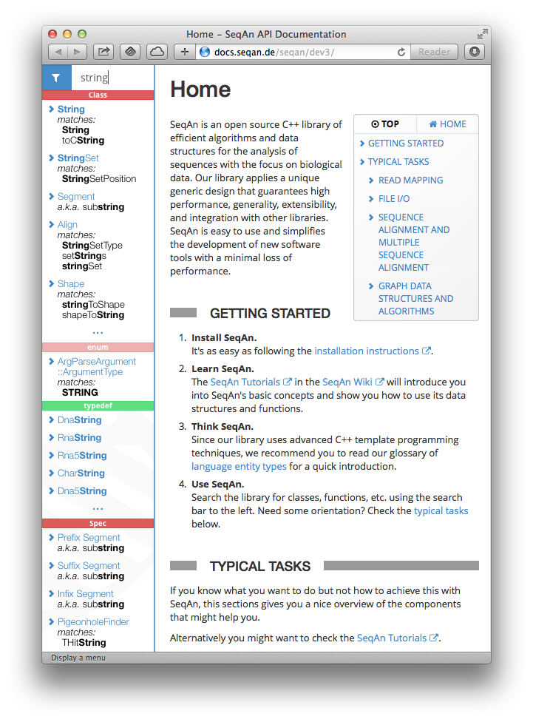
Space-saving
Notes:
Space-Saving Scales nicely from tablet to large screens

Slide 33
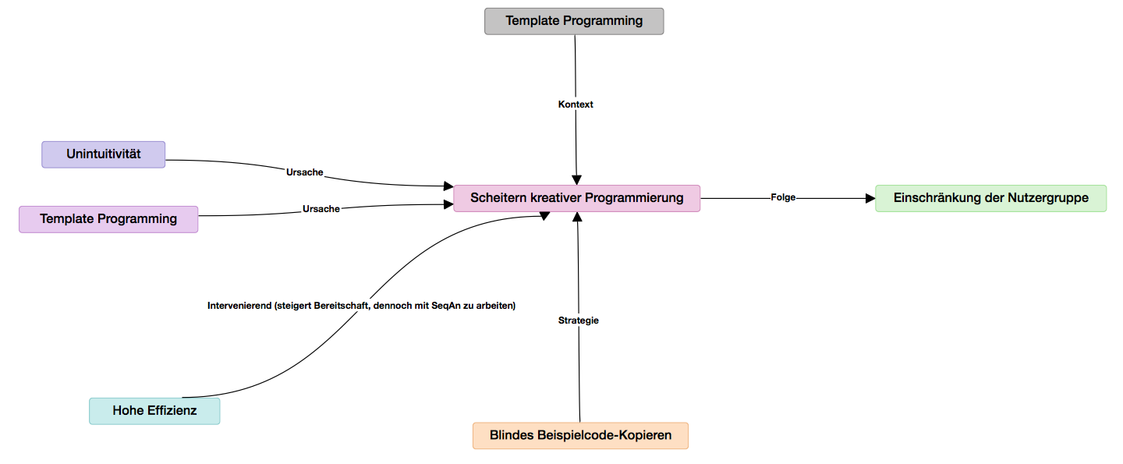
Improvements
Research not completed, yet
Deep insights expected
Notes:
Currently Grounded Theory based data analysis using own data analysis tool.
Has never been done before.
Expaction: deeper understanding of the nature and mechanisms of SeqAn‘s core usability problems
Generalizable to similar libraries / frameworks

Slide 34
SeqAn SDK

Slide 35
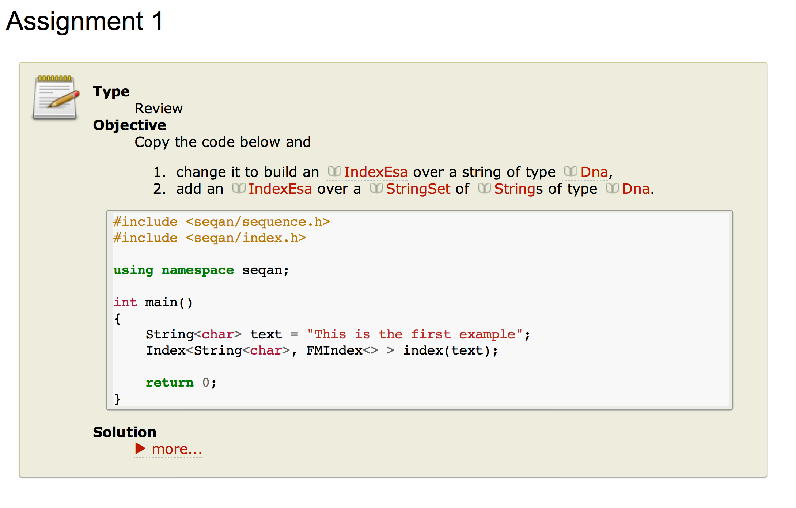
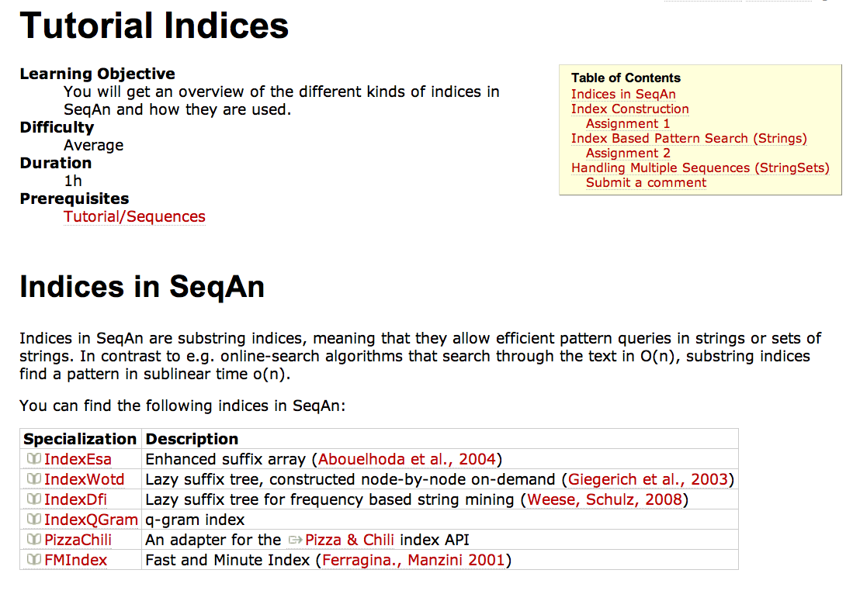
SeqAn SDK Components - Tutorials

Slide 36
SeqAn SDK Components – Reference Manual

Slide 37
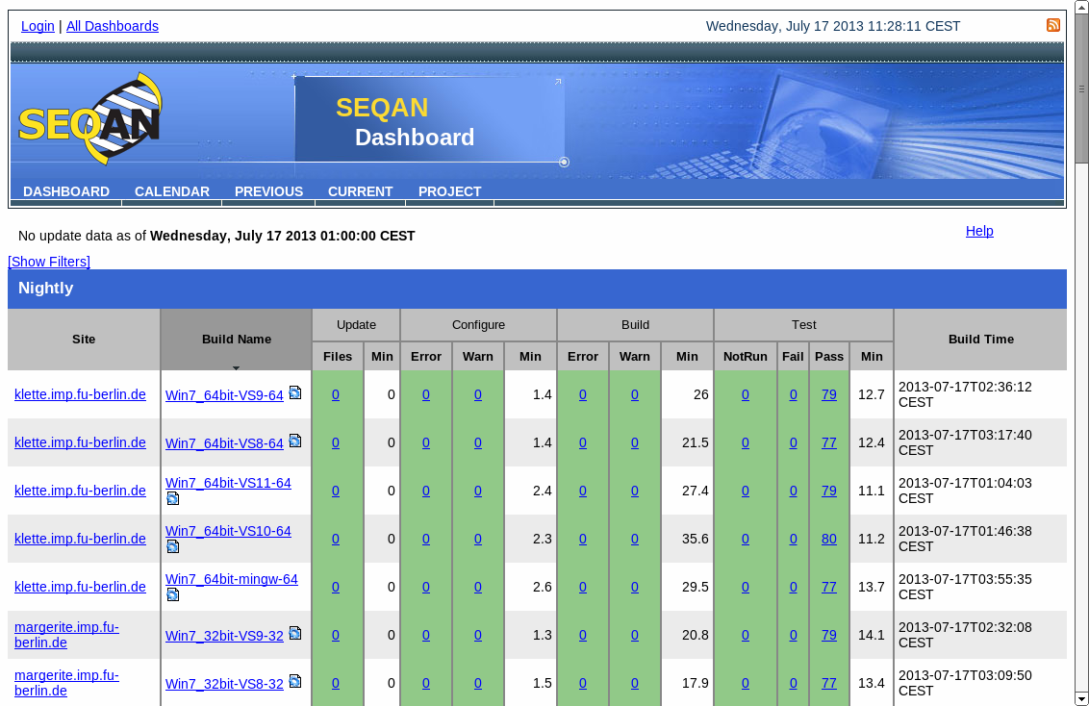
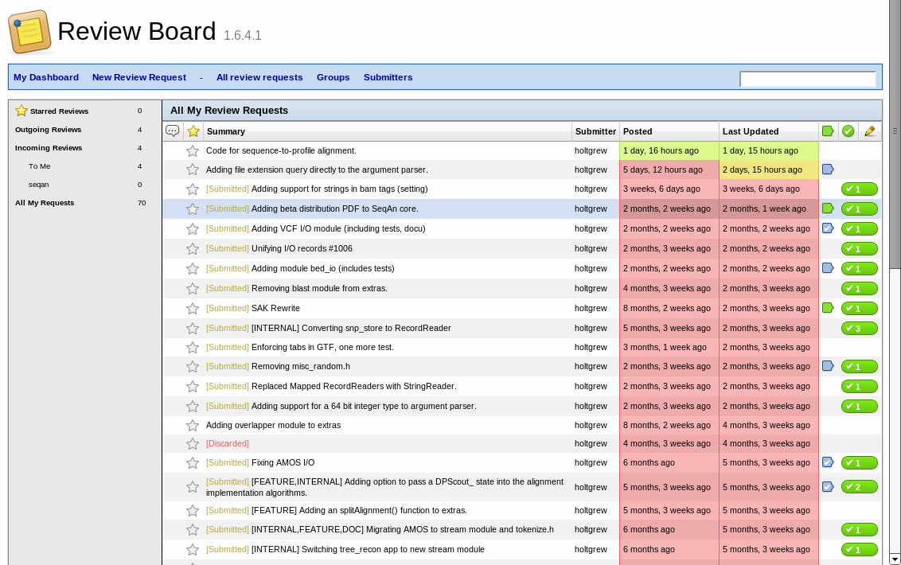
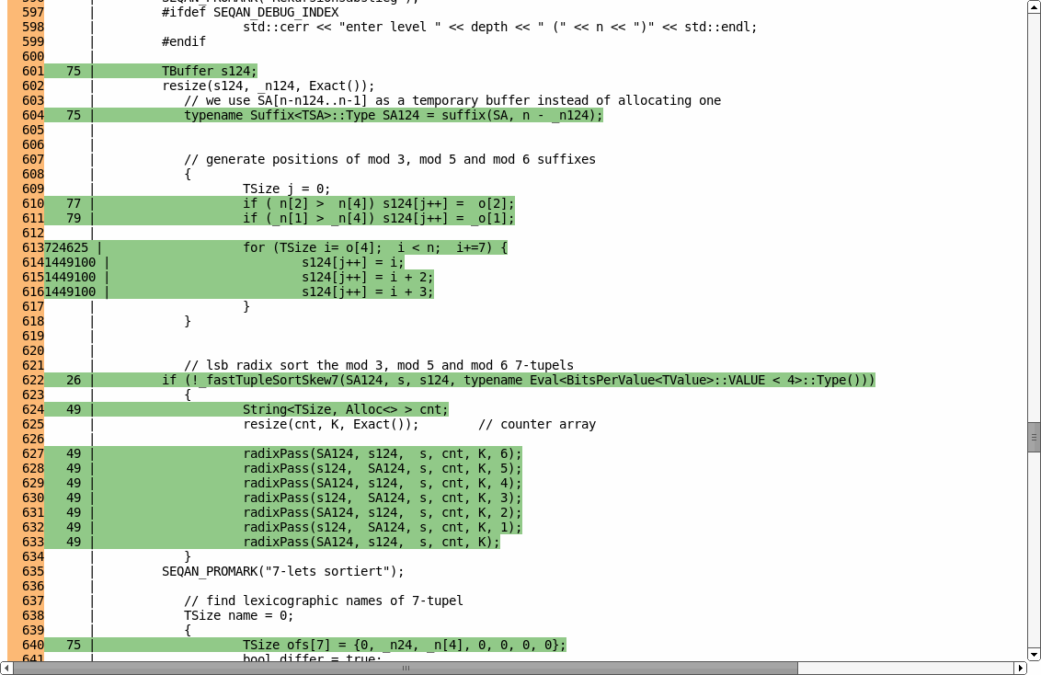
SeqAn SDK Components
David Weese, FU Berlin
today
Review Board to ensure code quality
CDash/CTest to automatically compile and test across platforms
Code coverage reports

Slide 38
SeqAn Content algorithms & data structures

Slide 39
Unified Alignment Algorithms
Versatile & Extensible DP-Interface
For Example ...
Standard DP-Algorithms
Global & Semi Global Alignments Local Alignments
Modified DP-Algorithms
Split Breakpoint Detection Banded Chain Alignment

Slide 40
Unified Alignment Algorithms
Configure
Central Configuration
DPProfile_<TAlgorithm, TGaps, TTrace>
Compile
… selects code snippets accordingly
… generates desired DP-Algorithm
Run
Unbanded DP-Algorithms Banded DP-Algorithms

Slide 41
Unified Alignment Algorithms
For Example ...
Needleman-Wunsch with Traceback:
DPProfile_<GlobalAlignment_<>, LinearGaps, TracebackOn<> >
Semi-Global Gotoh without Traceback:
DPProfile_<GlobalAlignment_<FreeEndGaps_<True, False, True, False> >, AffineGaps, TracebackOff>
René Rahn, FU Berlin
today
Banded Smith-Waterman with Affine Gap Costs:
DPBand_<BandOn>(lowerDiag, upperDiag),
DPProfile_<LocalAlignment_<>, AffineGaps, TracebackOn<> >
Split-Breakpoint Detection for Right Anchor:
DPProfile_<SplitAlignment_<>, AffineGaps, TracebackOn<GapsRight> >

Slide 42
Unified Alignment Algorithms
... And how much slower is that? (pairwise alignment of 10kb Dengue virus sequences)

Slide 43
Unified Alignment Algorithms
... And how much slower is that? (affine alignment of 10kb Dengue virus sequences)

Slide 44
Support for Common File Formats
Important file formats for HTS analysis
Sequences
FASTA, FASTQ
Indexed FASTA (FAI) for random access
Genomic Features
GFF 2, GFF 3, GTF, BED
Read Mapping
SAM, BAM (plus BAM indices)
Variants
VCF
SequenceStream ss(“file.fa.gz”);
while (!atEnd(ss))
{
readRecord(id, seq, ss);
cout << id << '\t' << seq << '\n';
}
Manuel Holtgrewe, FU Berlin
today
BamStream bs(“file.bam”);
while (!atEnd(bs))
{
readRecord(record, bs);
cout << record.qName << '\t' <<
record.pos << '\n’;
}
… or write your own parser
Tutorials and helper routines for writing your own parsers.

Slide 45
Journaled Sequences
Store Multiple Genomes
Save Storage Capacities
StringSet<TJournaled, Owner<JournalSet> > set;
setGlobalReference(set, refSeq);
appendValue(set, seq1);
join(set, idx, JoinConfig<>());
String<Dna, Journaled<Alloc<> > >
Ref:
G₁:
G₂:
•••
•••
G_{N}:

Slide 46
Main idea
Process multiple sequences with sequential algorithm
s⁰:
s¹:
s²:
s³:
…
Notes:
CDFGDC
CDEFGAHGC

Slide 47
Main idea
Process multiple similar sequences
s⁰:
0: 531
1: 545
2: 531
3: 545
s¹:
1: 245
3: 245
s²:
s³:
Notes:
CDFGDC
CDEFGAHGC

Slide 48
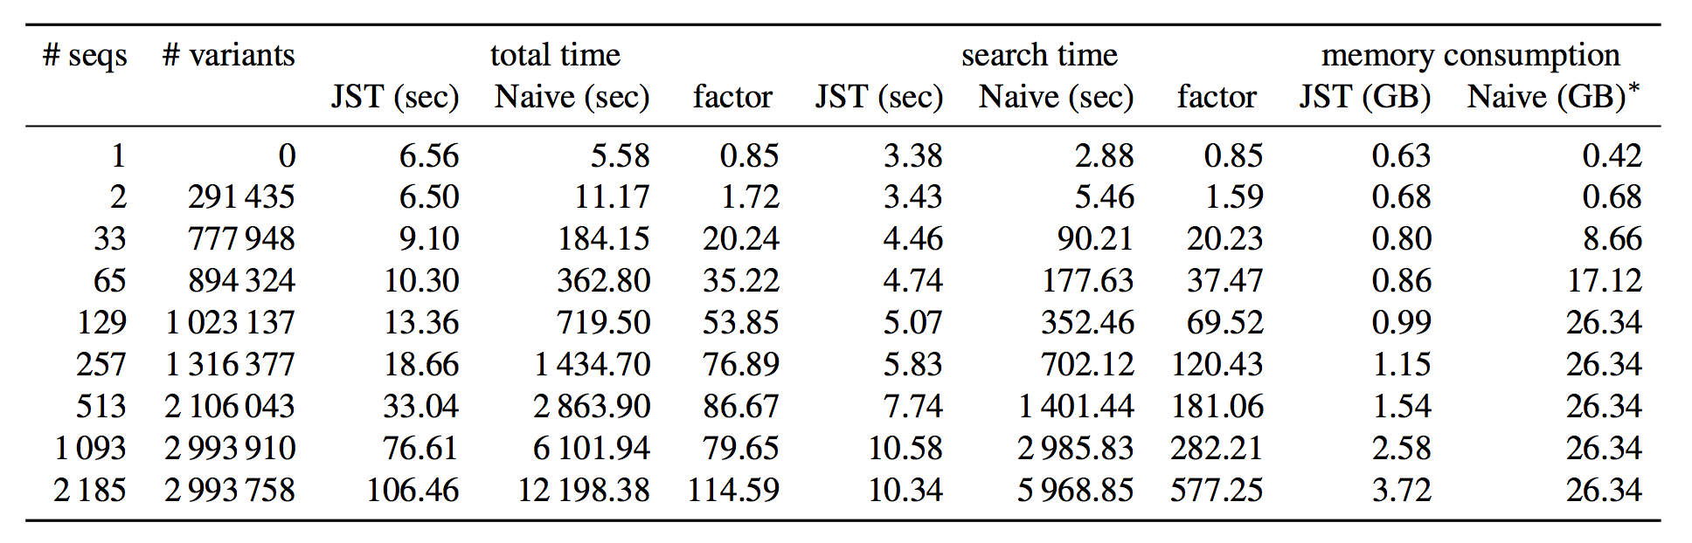
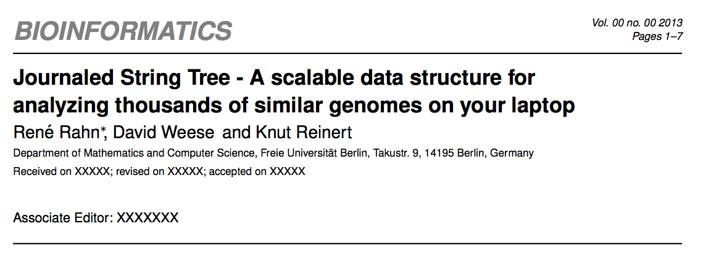
Appr. Pattern search in 1000 gen.
Talk by René Rahn
today

Slide 49
Fragment Store
All-In-One Data Structure for HTS
Designed to represent:
reads, mate-pairs, reference genomes
pairwise alignments
genome annotations
Easy-to-use interface and high-level functions for typical workflows.
Genome Annotations
Annotation files can easily be imported (GFF/GTF/UCSC):
The annotation tree can be traversed with iterators:
CDS
exon
FragmentStore<> store;
read(file, store, Gff());
mRNA
gene
exon
root
mRNA
exon
exon
gene
CDS
Iterator<TStore, AnnotationTree<> > it(store);
goDown(it);
mRNA
exon
exon
CDS

Slide 50
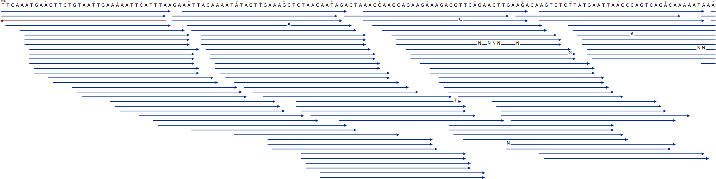
Fragment Store
(Multi) Read Alignments
Read alignments can be easily imported:
… and accessed as a multiple alignment, e.g. for visualization:
std::ifstream file("ex1.sam");
read(file, store, Sam());
AlignedReadLayout layout;
layoutAlignment(layout, store);
printAlignment(svgFile, Raw(), layout, store, 1, 0, 150, 0, 36);

Slide 51
Unified Full-Text Indexing Framework
Available Indices
All indices support multiple strings and external memory construction/usage.
Suffix Trees:
suffix array
enhanced suffix array
lazy suffix tree
Prefix Trie:
FM-index
q-Gram Indices:
direct addressing
open addressing
gapped
Index<TSeq, IndexEsa<> >
Index<StringSet<TSeq>, FMIndex<> >
Index Lookup Interface
All indices support the (sequential) find interface:
Finder<TIndex> finder(index);
while (find(finder, "TATAA"))
cout << "Hit at position" << position(finder) << endl;

Slide 52
Unified Full-Text Indexing Framework
String Tree Interface
Suffix/prefix trees can be accessed with iterators that support different traversals:
top-down
depth-first search
random
David Weese, FU Berlin
today
Iterator<TIndex, TopDown<> >::Type it(index);
goDown(it, 'a');
suffix tree
Advanced Index Algorithms
Repeat search iterators
for maximal/supermaximal repeats and maximal unique matches
Pattern search with backtracking
parallel exact/approximate search of multiple patterns (tree vs. tree)
q-gram filters
counting/seed filters for approximate pattern search and local alignments

Slide 53
Applications

Slide 54
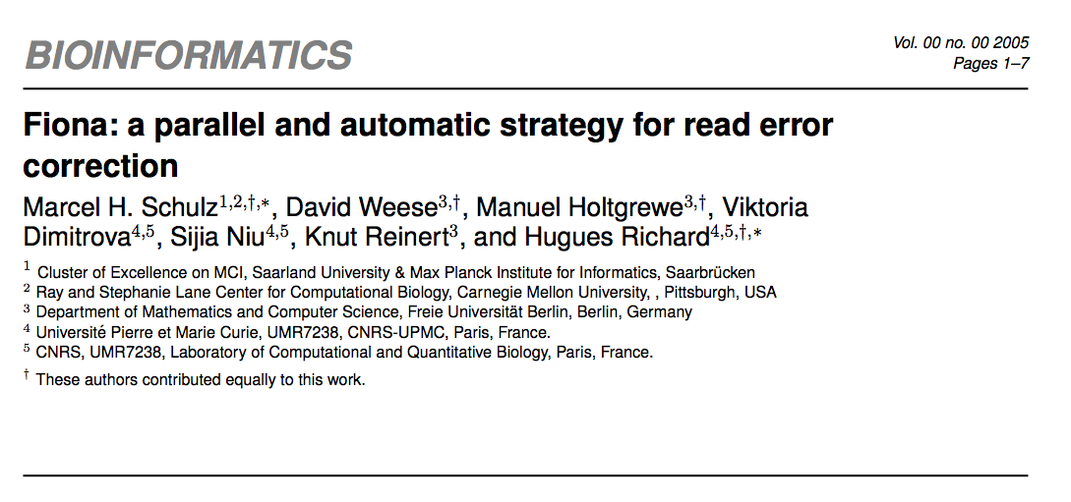
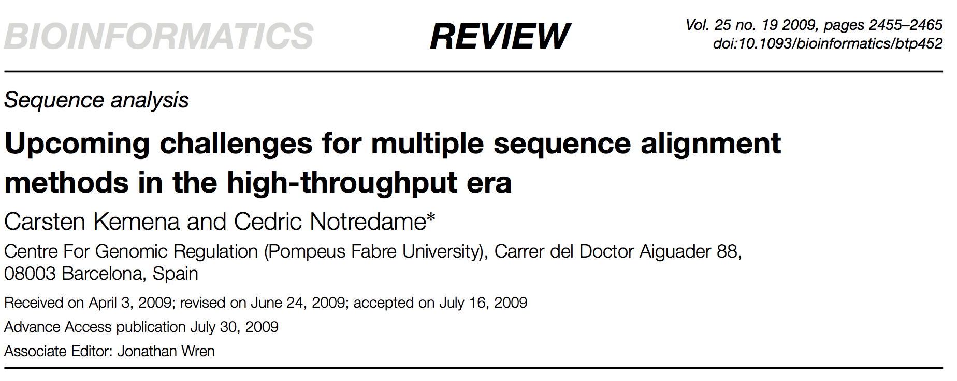
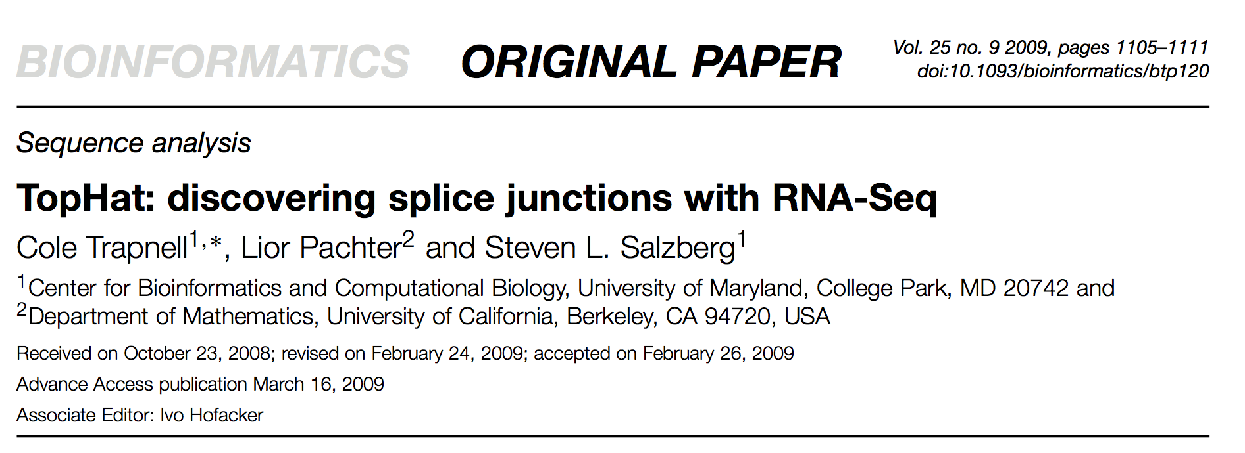
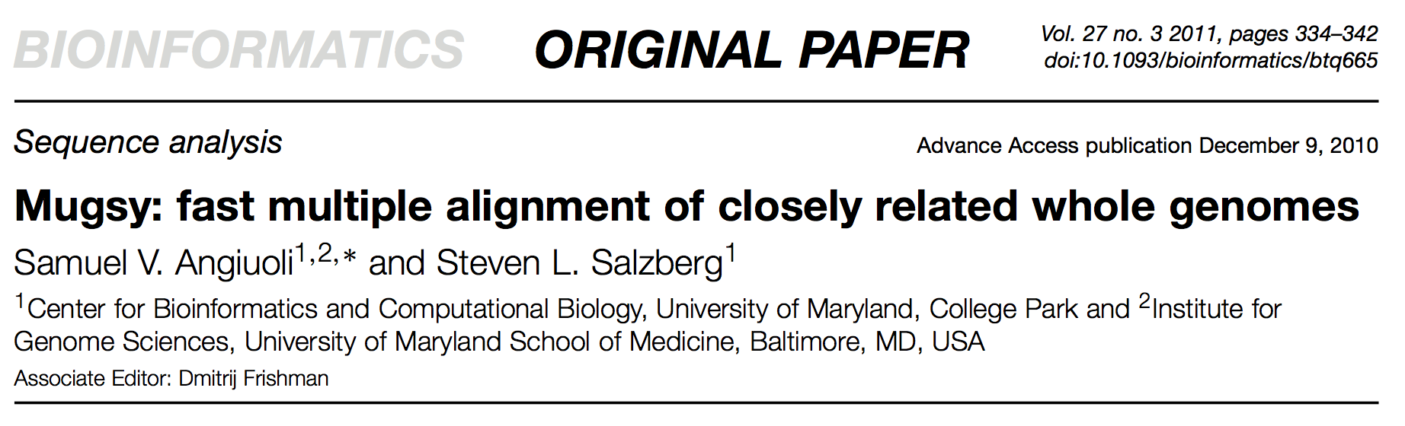
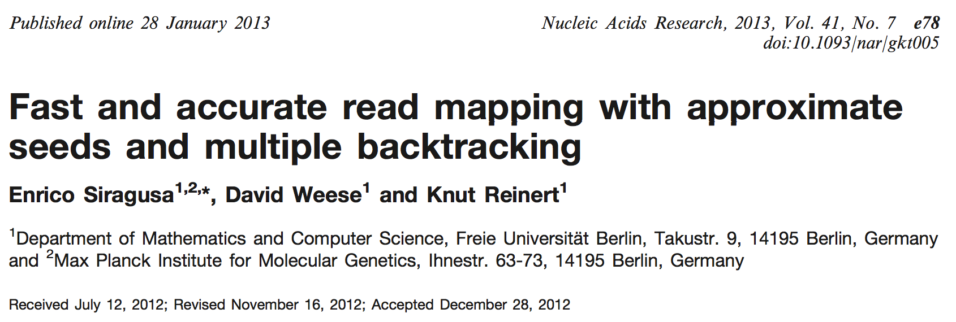
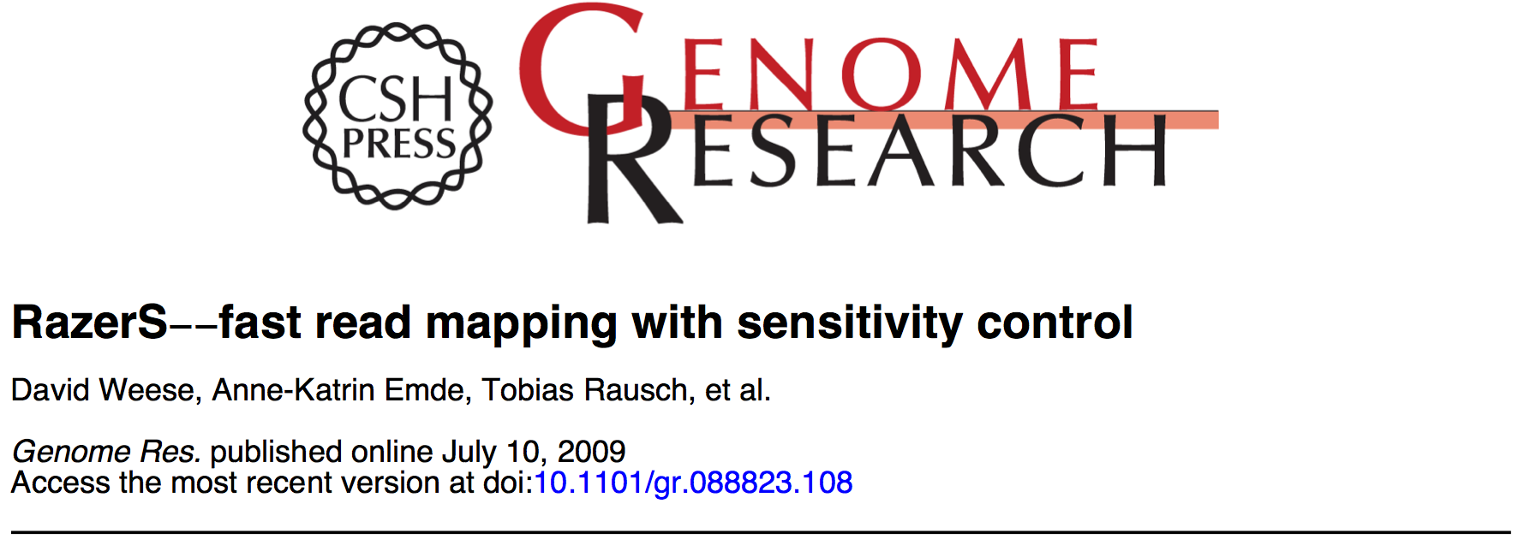
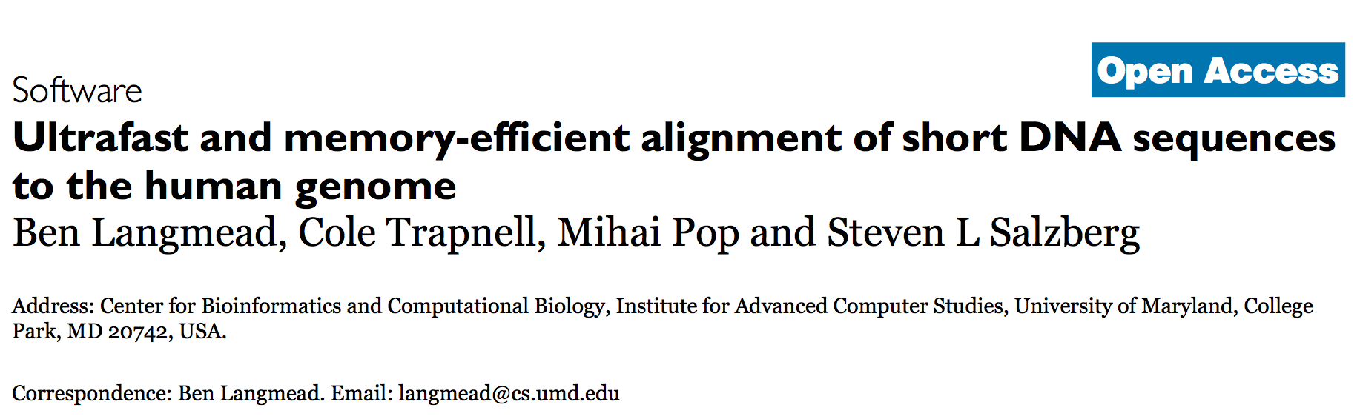




John Reid, Institute of public health Cambridge, UK
Tomorrow
Marcel Schulz,
Cluster on Excellence on MCI
Saarland university
Tomorrow

Slide 55
STELLAR – exact local aligner
... finds all maximal ε-matches in short time.
Filtering
Index module
sequence 1
Index <TSeq, IndexQGram>
Finder<Tsequence,Swift<SwiftLocal> >
sequence 2
Verification

Slide 56
STELLAR – exact local aligner
Verification
Alignment module
Align <Tseq>
LocalAlignmentEnumerator<TScore, Banded>
Seeds module
Seed <Simple>
extendSeed(seed, ...,GappedXDrop())

Slide 57


Stellar – exact local aligner
Stellar is based on a SWIFT filter and allows epsilon threshold matches with X-drops

Slide 58

Exact vs. Heuristics
E-value 6x10⁻⁸⁴ not found by standard BLAST

Slide 59


Gustaf: multi-split mapping
... for structural variant detection
Find partial alignments using STELLAR
Inversion
CTGGGGGACTTGGCAGATCTCACCGTCACCAACGACAACGACCTCAGCTGCGATGTGGAGATTCTGGACGCAAAGACAAGGGAGAAGCTGTGTTTCTTGGA
Overlapping STELLAR matches
Breakpoints
?
Split-read graph & exact breakpoint calculation

Slide 60



Gustaf: multi-split mapping
Split-read graph & exact breakpoint calculation
Graph module
chr: 19
db: 14673330...14673384
read: 48...102
1
0
2
3
chr: 19 (compl.)
db: 47230700...47230763
read: 1...66
0
start
0
end
102
chr: 4 (compl.)
db: 125384889..125384931
read: 55...97
2
5
Alignment module
splitAlignment(alignL,alignR,…)
2 = 2 – 5 + 5 (inversion penalty)

Slide 61
Splazers: split read mapping
Combination of split matches
SplazersS is based on a SWIFT filter and allows large indels

Slide 62



Splazers: split read mapping
Acceptable speed and very sensitive
Anne-Katrin Emde, New York Genome Center
tomorrow

Slide 63
SeqAn::T-Coffee
Graph-Based Multiple Sequence Alignment
Pairwise Library Computation
String<AminoAcid>
align module
Align<Dna5String> align;
globalAlignment(align, Blosum60());
Graph-Based Progressive Alignment
NG--SQY
--CCSQY
--CCSQY
graph_align module
NG
SQY
Graph<Alignment<TStringSet>> g(strings), gOut;
buildAlignmentGraph(fragments, scores, Blosum60);
tripletLibraryExtension(g);
upgmaTree(matrix, guideTree);
progressiveAlignment(g, guideTree, gOut);
CC
SQY
CC
SQY

Slide 64
MASON – A Sequence Simulator
Versatile simulation of Nucleic/HTS Data
Variants, Methylation Levels, Transcript Splicing
Simulate SNPs, DIPs, SVs, write VCF/FASTA
Apply variants from VCF to FASTA
Simulate methylation levels for genome based on context
Generate transcripts from FASTA + GFF/GTF
Read Simulation
Illumina/454/Sanger, SE-PE
Variants from VCF file
BS-Seq simulation given methylation levels

Slide 65
SeqAn Performance

Slide 66


Masai read mapper
Reads
Genome
Chr. 1
Chr. 2
Chr. X
ACGCTTCATCGCCCT…
Index of reads
(Radix tree of seeds)
Index of genome
(e.g. FM-index)
Algorithm is based on the simultaneous traversal of two string indices (e.g., FM-index, Enhanced suffix array, Lazy suffix tree)

Slide 67

Masai read mapper
Lambda
Jochen Singer FU Berlin
tomorrow
Yara
David Weese
FU Berlin
tomorrow

Slide 68
Yara – Yet Another Read Aligner
Fast and accurate read alignment by strata
Sequencing Platforms
Illumina HiSeq and MiSeq
Supports single-end, paired-end and mate-pairs protocols
Ion Torrent Proton and PGM
Supports quality-trimmed reads
Features
Low memory footprint [Requires only 5GB of RAM for hg19]
Multi-threaded [Maps >10Gbp/h on my laptop!]
Compressed I/O [Gzip/bzip2 FastQ → SAM/BAM]
Easy to use [Simply choose best or all mapping]
Ready to use [Tested with KNIME and the GATK]

Slide 69
Yara – Yet Another Read Aligner
Performance on Human WGS – Illumina HiSeq (on Desktop !, 4 core i7, 32 GB)
2 to 4 times speed-up pending !

Slide 70


Lambda – The Local Aligner for Massive Biological DAta
Slightly faster and slightly more sensitive than RapSearch2 and UBlast

Slide 71


Read Mapping: Masai
Faster and more accurate than BWA and Bowtie2
Timings on a single core

Slide 72

No bias in SNP/Sequencing error

Slide 73

Easily exchange index….

Slide 74

Upcoming in SeqAn
Generic and specialized
Acceleration support
Collaboration to parallelize indices and verification algorithms in SeqAn, to speed up any applications making use of indices

Slide 75

SeqAn going parallel
GOAL
Parallelize the finder interface of SeqAn
so it works on CPU and accelerators like GPU
Will be replaced by hg18 and 10 million 20-mers

Slide 76

SeqAn going parallel
Construct FM-index
on reverse genome
Set # OMP threads
Call generic count function

Slide 77

SeqAn going parallel : NVIDIA GPUs
Copy needles and index to GPU
SAME count function as on CPU !

Slide 78



SeqAn going parallel
Count occurrences of 10 million 20-mers in the human genome using an FM-index
18.6 sec
I7,3.2 GHz
1 X
2.66 sec
7 X
…12...
Intel Xeon Phi 7120, 244 threads
2.18 sec
8.5 X
NVIDIA
Tesla K20
0.4 s
47 X

Slide 79
SeqAn going parallel
Approx. count occurrences of 1.2 million 33-mers in the human genome using an FM-index
66.1 s
I7,3.2 GHz
1 X
9.0 s
7.3 X
…12...
Intel Xeon Phi 7120, 244 threads
16.9 X
3.9 s
NVIDIA
Tesla K20
3.2 s
20.7 X

Slide 80

CPU vs. GPU
Invoking an FM-index based search on CPU and GPU:
The findGPU kernel AND the findCPU function will invoke many instances of the SAME generic function which will perform a backtracking algorithm on our generic index interface
// Select the index type.
typedef Index<DnaString, FMIndex<> > TIndex;
// Type is Index<device_vector<Dna>, FMIndex<> >.
typedef typename Device<TIndex>::Type TDeviceIndex;
// ======== On CPU ======== // ========== On GPU ===========
// Create an index. // Create a device index.
TIndex index("ACGTTGCAA"); TIndex index("ACGTTGCAA");
TDeviceIndex deviceIndex;
assign(deviceIndex, index);
// Use the FM-index on CPU. // Use the FM-index in a CUDA kernel.
findCPU(index,…); findGPU<<<...>>>(view(deviceIndex),…);
template <typename TIndex> template <typename TIndex>
void __global__ void
findCPU(TIndex & index,…); findGPU(TIndex index,…);
Notes:
Here you can see the differences between actual code that invokes a finder on an index.

Slide 81
Upcoming in SeqAn
Workflow integration

Slide 82
Generic workflow nodes
GWN

Slide 83

Library Integration
Give every tool a self-describing output format: semantic annotation of its inputs/outputs
In OpenMS and SeqAn we developed CTD (Common Tool Description) for this purpose
Each tool can thus ‘tell’ its requirements and options in a coherent format
All interfaces are fully described by this format
Information on the tools options, I/O are entirely contained within the individual tool (maintenance!)

Slide 84
CTD Format
General tool description in header
<tool name="MasaiMapper" version="0.7.1 [14053]" docurl="http://www.seqan.de" category="Read Mapping" >
<executableName>masai_mapper</executableName>
<description>Masai Mapper</description>
<manual>Masai is a fast and accurate read mapper based on approximate seeds and multiple backtracking.
See http://www.seqan.de/projects/masai for more information.
(c) Copyright 2011-2012 by Enrico Siragusa.
</manual>
<cli>
<clielement optionIdentifier="--write-ctd-file-ext" isList="false">
<mapping referenceName="masai_mapper.write-ctd-file-ext" />
</clielement>
........

Slide 85
Node generator
GWN
Generic workflow nodes can generate nodes to be used in e.g. KNIME.
https://github.com/genericworkflownodes
It is compatible with both internal and external tools. This means, ANY tool can be integrated in KNIME as long as it has a CTD.

Slide 86

Integrating CTD Tools in KNIME

Slide 87






Workflows Enabling Software Re-Use
External tools
automatic
automatic
automatic
manuel
CTD
script
script
program

Slide 88

Workflows Enabling Software Re-Use
David Weese, FU Berlin
today

Slide 89

Tool Integration in KNIME

Slide 90
The future of SeqAn

Slide 91


SeqAn- an infrastructure resource
VIP (Verwertung des InnovationsPotentials wissenschaftlicher Forschung)
CUDA research center (SeqAn project was awarded the status of CUDA research center)
BMBF infrastructure center CIBI (Tü/B/K) (SeqAn is explicitely mentioned in the center as resource and was successful in the first round)

Slide 92



THANK YOU for your attention
The OpenMS and SeqAn teams (Berlin, Tübingen, Zürich)
The KNIME team (Michael Berhold, Konstanz)
NVIDIA (Jacopo Pantaleoni, Jonathan Cohen)
www.seqan.de, www.openms.de

